Slide 1

Maxab Market place case study
By: Rami Hani
Notes:
NOTE:
To change the image on this slide, select the picture and delete it. Then click the Pictures icon in the placeholder to insert your own image.

Slide 2
CASE STUDY MAIN TASKS
Calculate May Retention Rate
Calculate Growth Rate Metrics Across different Districts
Calculate the Total Monthly Burn for April and May
Show Weekly Percentage Contribution of every channel from the total weekly orders for April and May
Calculate the Total Monthly percentage of App users and Telesales users from the total retailers of May
Total Sales Orders and Total Revenues for the rest of June for every retailer
Calculate Days on hand for all SKUs
Calculate the stocks to be purchased from suppliers per SKU to reach 7 days on hand for all SKUs.

Slide 3
1 – Calculation of May retention rate

Slide 4
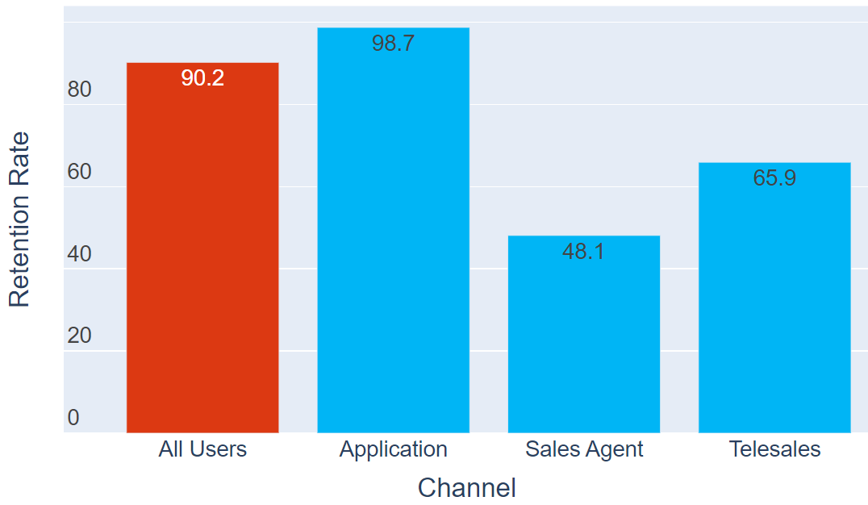
May Retention Rate

Slide 5
Techniques to Improve The Retention Rate
Personalize a profile for each retailer to support his satisfaction with the service so he would come back again to use the application.
Send surveys to learn more about your customers for improved personalization.
Focusing on acquiring only high-value customers.
Retarget one-time buyers at the right time to encourage a second sale.
Try to achieve Early Delivery every time to increase retailer’s satisfaction.
Trust is the basis for good relationships, so the company must keep almost all high demand SKUs in stock to be available at any time when needed by retailers.

Slide 6
2 – Growth metrics across districts

Slide 7
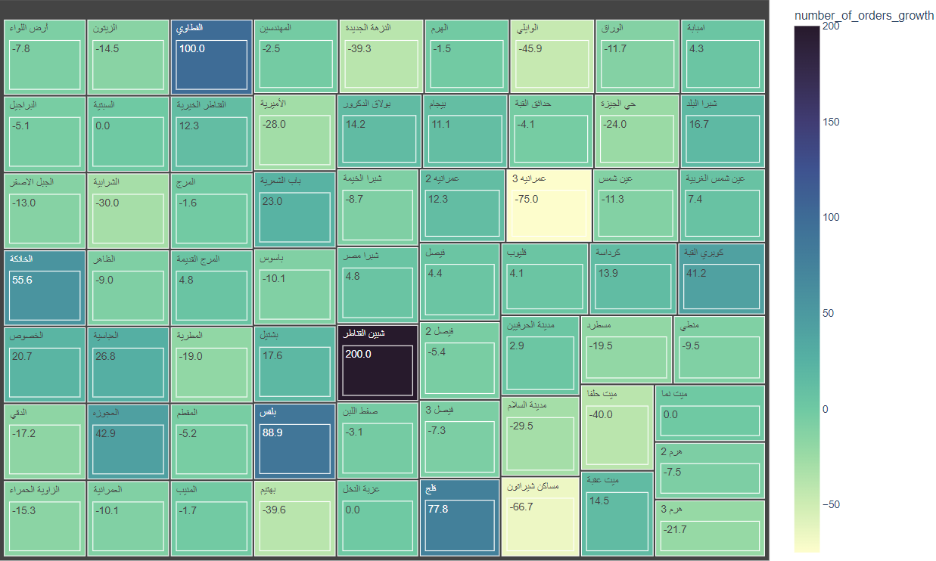
1. Number of Orders Per District Growth Rate [ April – May ]

Slide 8
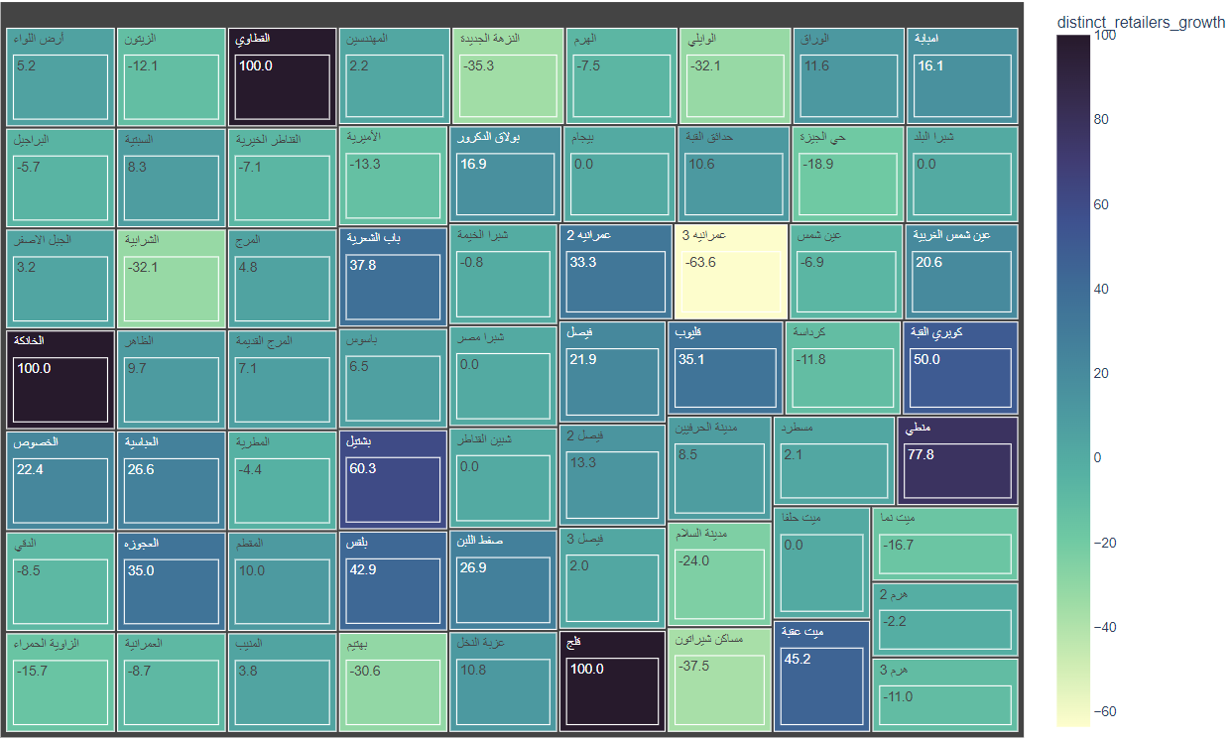
2. Distinct Retailers Growth Rate Per District [ April – May ]

Slide 9
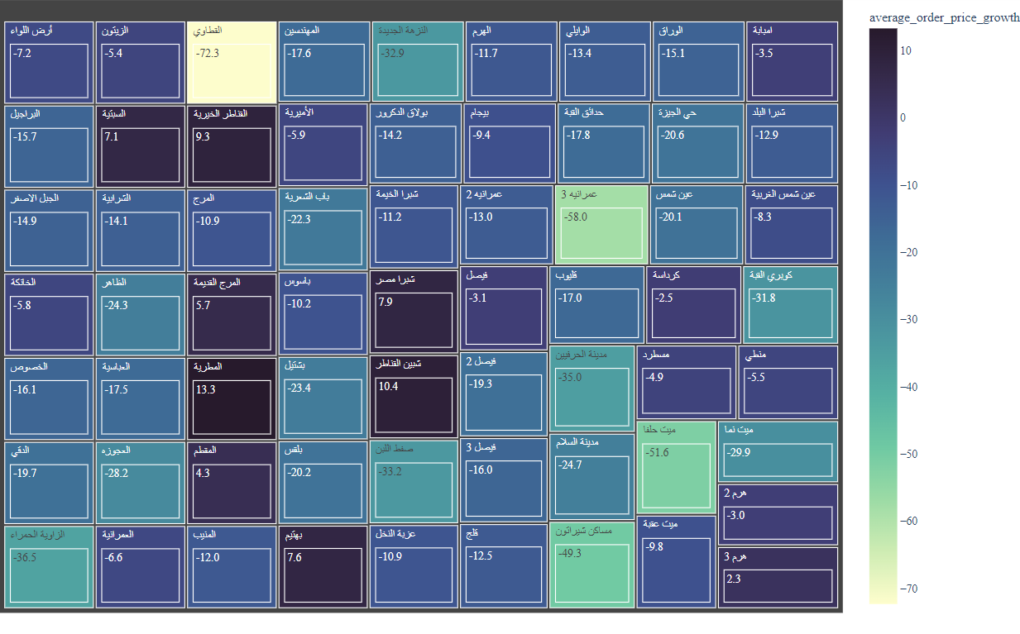
3. Average Order Price Growth Rate Per District [ April – May ]

Slide 10
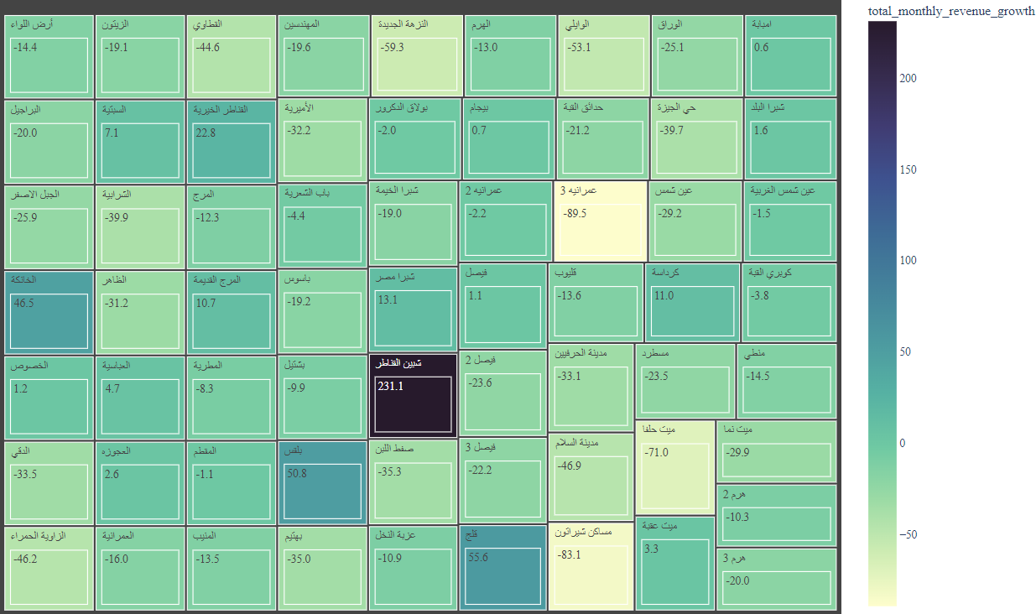
4. Total Revenue Growth Rate Per District [ April – May ]

Slide 11
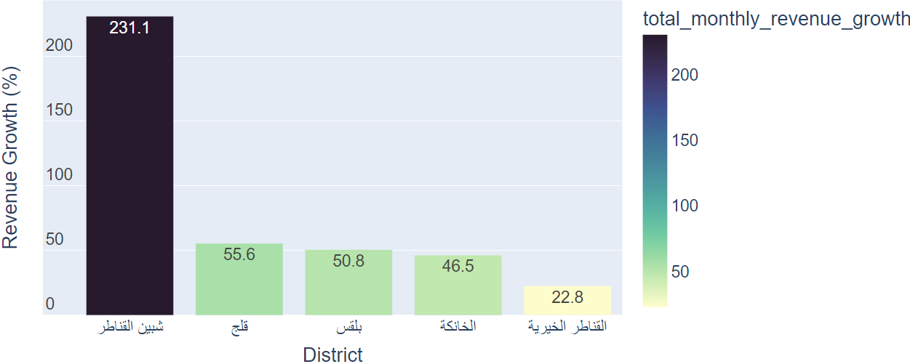
5. Top 5 Districts in Terms of Revenue Growth [ April – May ]

Slide 12
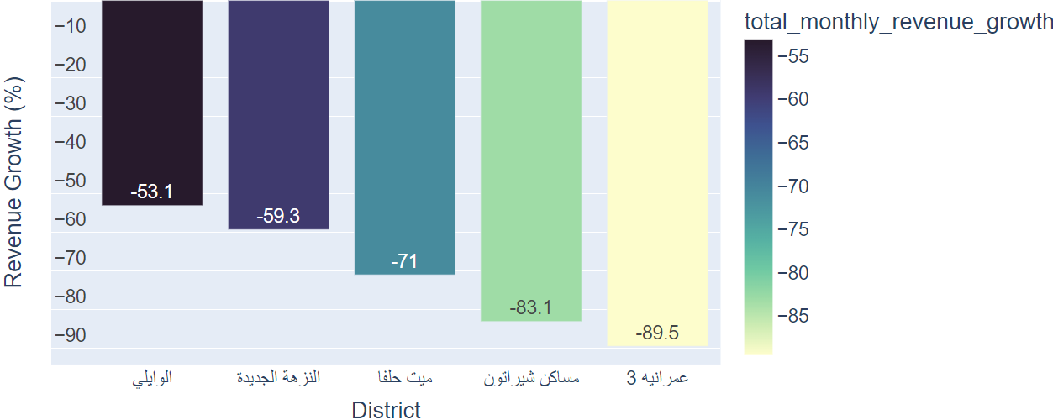
6. Least 5 Districts in Terms of Revenue Growth [ April – May]

Slide 13
Comments On Capitalizing and Shutting Down Districts
For every district, We should keep track of several month’s data in order to decide whether to capitalize on these districts or shut them down.
In the month of May, we saw some districts that have great Revenue Growth like " شبين القناطر “, If it continues this trend in June, We must capitalize this district.
I suggest to increase the number of ads targeting retailers in those districts.
On the other hand, for districts with Negative Revenue Growth like "عمرانية 3" ، "مساكن شيراتون")); there could be a problem that happens when delivering the order, we should note this problem for further orders in the same district or if the problem continues and the growth keeps trending down, we should shutdown the district completely.

Slide 14
3 – Burn Rate Calculation [April - May]

Slide 15
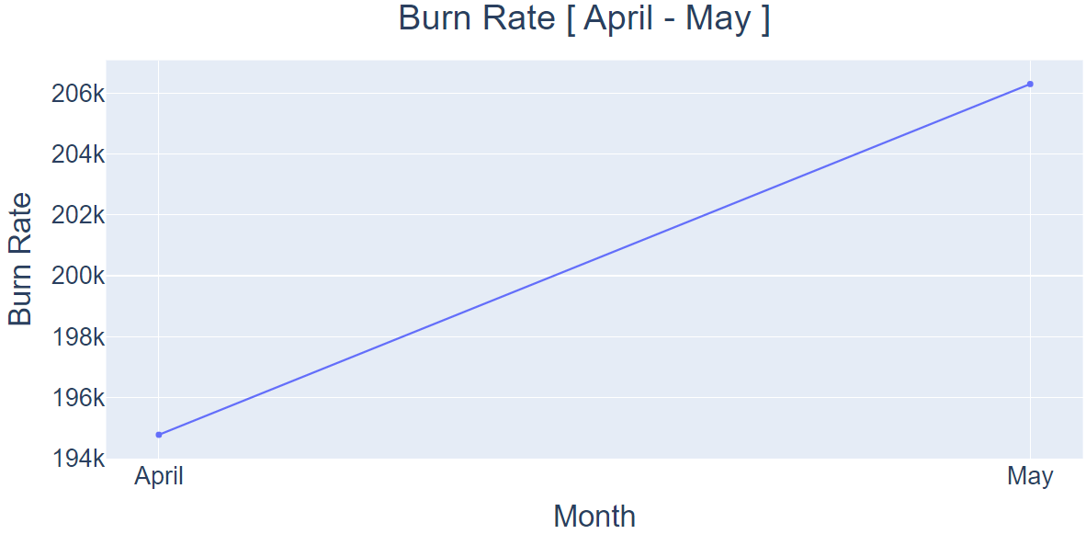
8. Total Monthly Burn Rate [ April – May]

Slide 16
Techniques To Decrease The Monthly Burn Rate
We can decrease the gross burn rate by prioritizing certain retailers to have discounts above other retailers based on some factors like the number of orders, revenue growth, retention rate, and whether the retailer is a new customer or not.
So, we can categorize each retailer in a segment and based on that segment we could offer him a suitable discount.
Decrease or Shutdown Ads for districts with negative growth rate or having a higher number of cancelled order due to common problems.

Slide 17
4 – Weekly percentage contribution of each channel in April & may

Slide 18
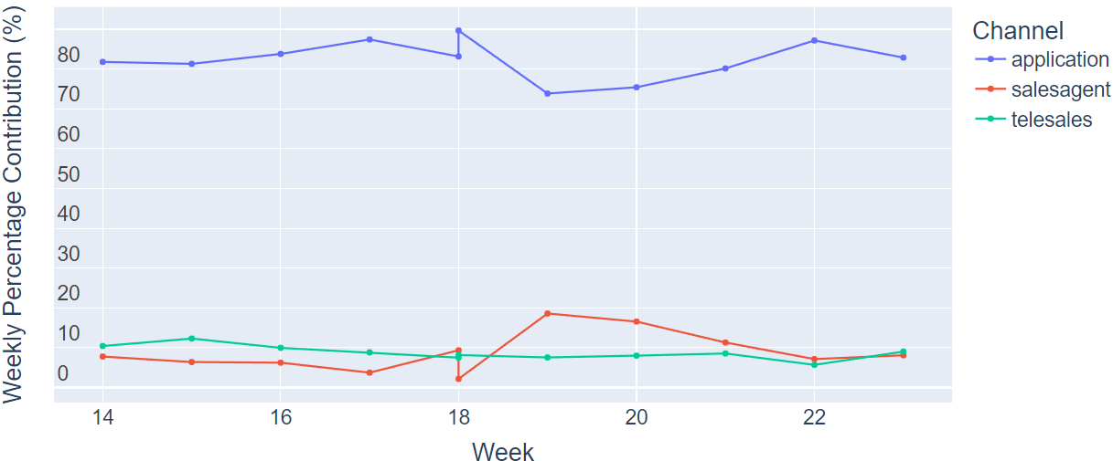
Weekly Contribution of different Channels [ April – May]
We can notice that Application Users have a higher weekly contribution among other channels.

Slide 19
5 – Application Vs Tele sales users' percentage in May

Slide 20
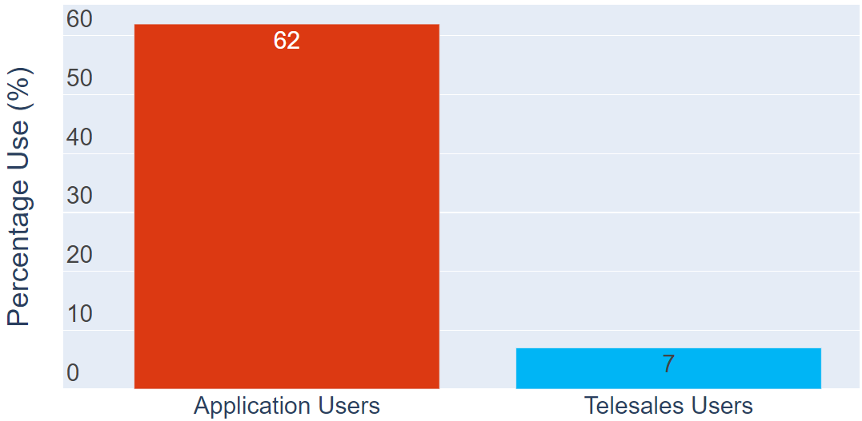
App Users Vs TeleSales Users Percentage [ May ]

Slide 21
Techniques To Increase Application Users Percentage
We can increase App Users percentage by Enhancing the design of the application and making it as simple and reliable as possible for retailers to use.
Sending a Push Notification welcoming users or providing useful information as users progress through the app to increase their satisfaction.
Adding a Live Chat feature in order to facilitate the communication for the retailer.
Improve Ad Spend and Encourage Social Sharing.

Slide 22
6 – projection of total sales orders and total revenues For June

Slide 23
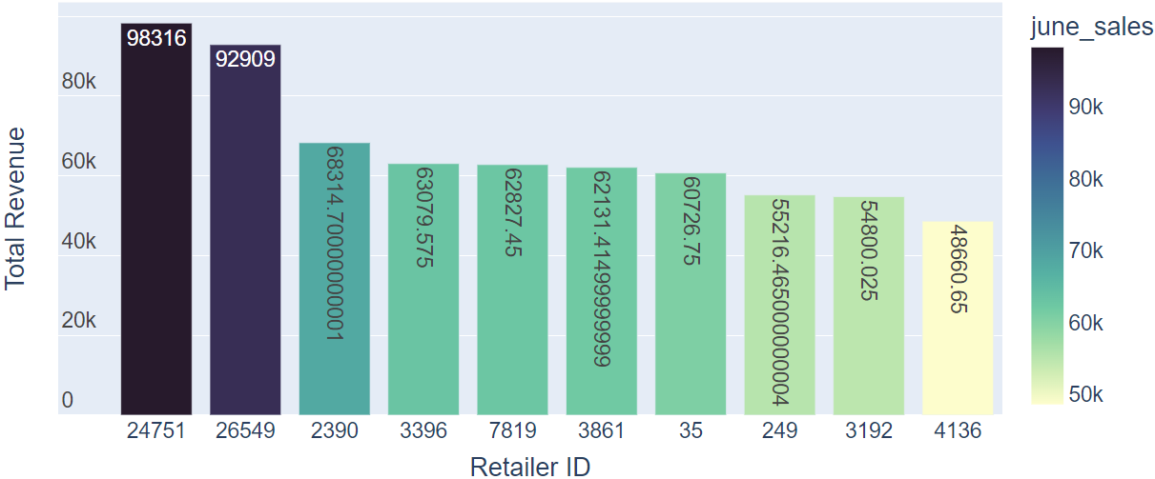
Top 10 Retailers in June [Revenue]

Slide 24
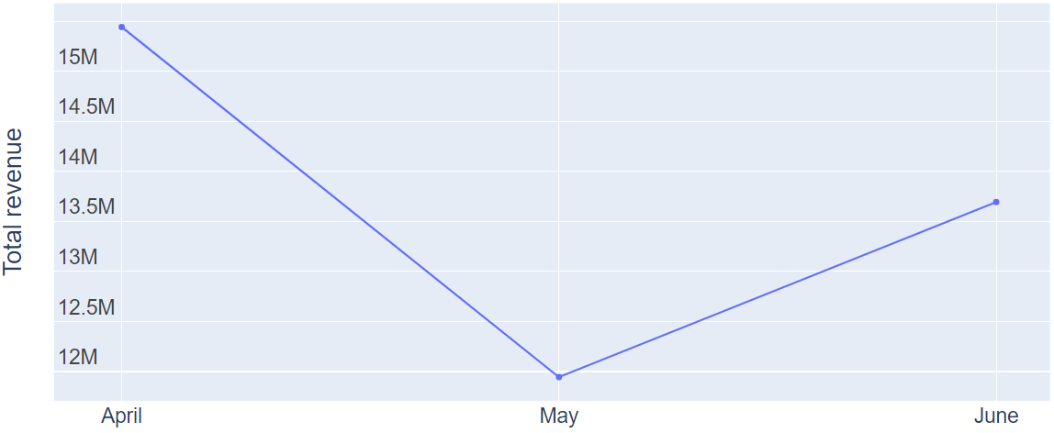
Total Monthly Sales [April - June]

Slide 25
7 – Calculate Days On Hands Per sku

Slide 26
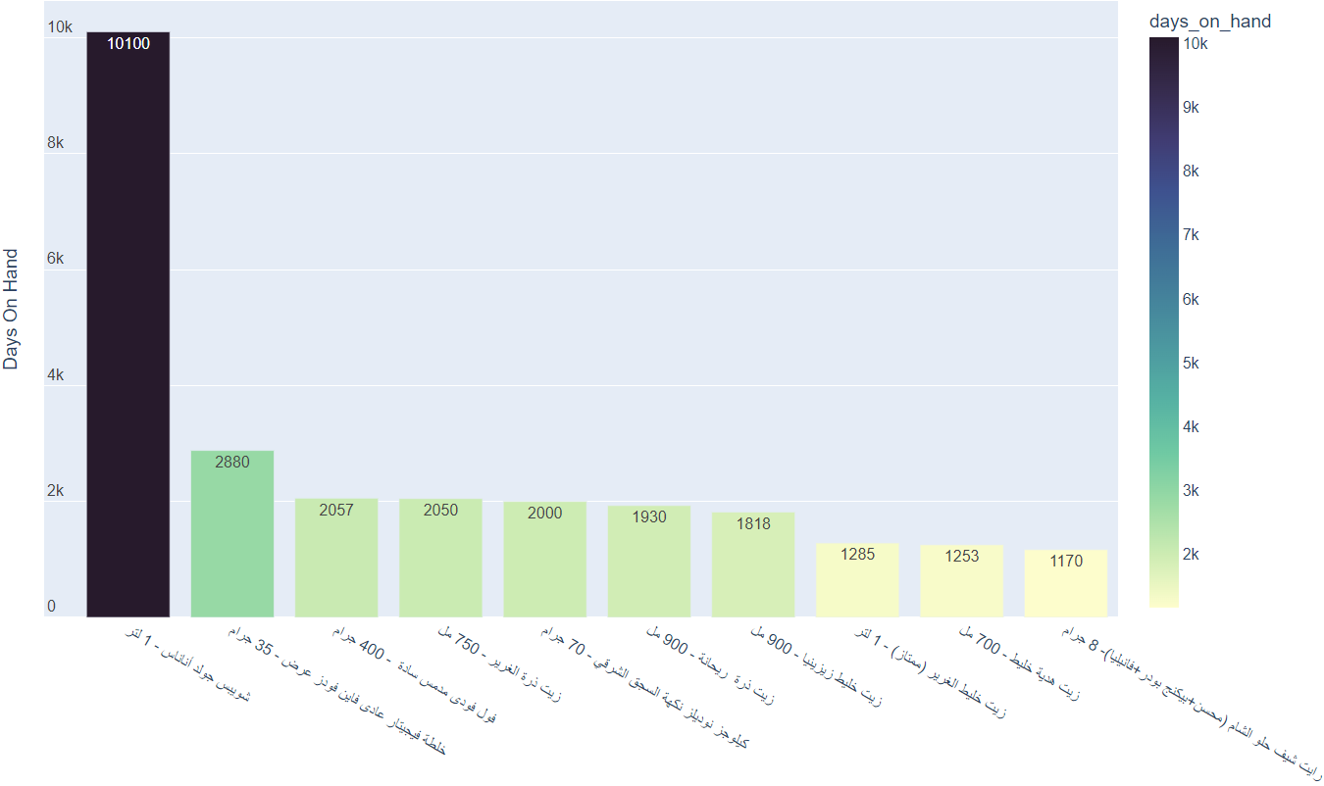
Top 10 Day On Hand SKUs

Slide 27
Alert For Out-Of-Stock SKUs
SKU | Stock | Days On Hand
صابون جو كريمي مع اللوز - 125 جرام | 1 | 0.0
حلوى هولز مينتول كبير 9 قطع - 5 جنية | 1 | 0.0
كارت فودافون - 4.25 جنية | 2 | 0.0
شاى ليبتون أخضر بدون مرارة (عرض) - 25 فتلة | 3 | 0.0
كارت اتصالات - 25 جنية | 1 | 0.0
دقيق الضحي - 1 كيلو | 34 | 0.0
صابون لوكس عرض - 120 جرام | 5 | 0.0
صابون جو كريمي مع الصبار و الليمون - 125 جرام | 1 | 0.0
كارت فودافون - 100 جنية | 2 | 0.0
كارت فودافون - 50 جنية | 4 | 0.0
جبنة دومتي بلس بالزيتون - 500 جرام | 5 | 0.0
سائل اطباق بريل متكرر - 35 جرام | 2 | 0.0
نسكافية بندق 3*1 ظرف (عرض) - 18 جرام | 9 | 0.0
صابون ديتول جدد نشاطك - 60 جرام | 3 | 0.0
ذرة فيشار الضحى - 500 جرام | 10 | 0.0
كيك دروو زبده - 5 جنية | 77 | 0.0
مشروب طاقة ستينج زجاج - 275 مل | 3 | 0.0
عصير بيتي جوافة (بلاستيك) - 1 لتر | 18 | 0.0
فيبا ليمون +600 جرام هدية - 4 لتر | 3 | 0.0
تاوتاو كيك الحليب مغطي بالشوكولاتةالبيضاء - 2... | 3 | 0.0
لبن بيتي كامل الدسم - 1 لتر | 12 | 0.0
مرقة خضار فاين فودز 12 مكعب - 108 جرام | 22 | 0.0
لبن بيتي كامل الدسم (عرض) - 1 لتر | 2 | 0.0
كلور كلوريل - 1050 جرام | 2 | 0.0
مياه اكوافينا - 1.5 لتر | 26 | 0.0
شاي ليبتون اخضر بالنعناع (عرض) - 25 فتلة | 1 | 0.0

Slide 28
8 – Calculating Number of stocks to be purchased

Slide 29
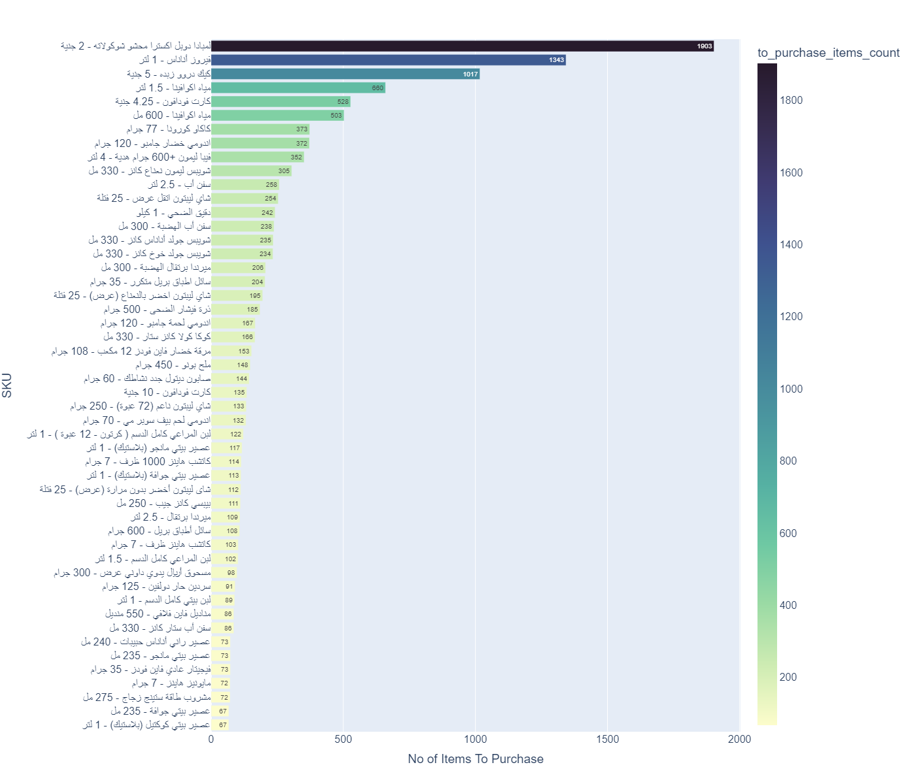
Purchase Need’s Per SKUs To Reach ( Days On Hold = 7 )

Slide 30
Thank you
Rami Hani

